Slide 1
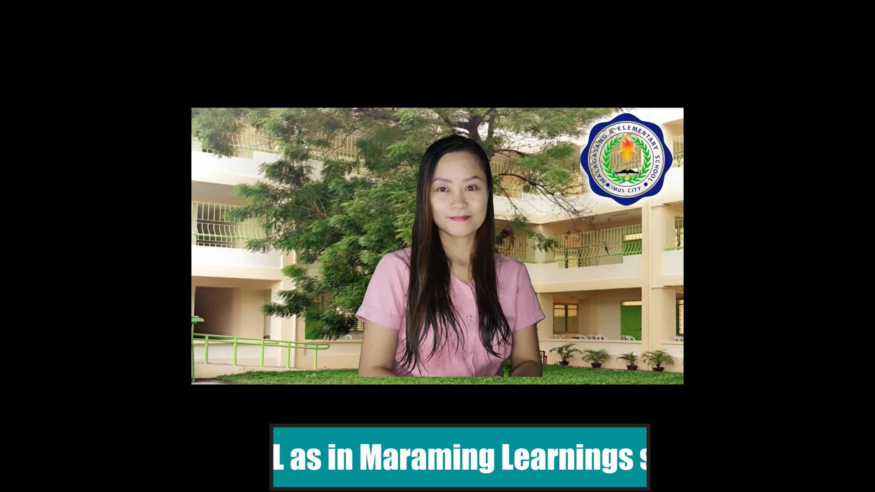
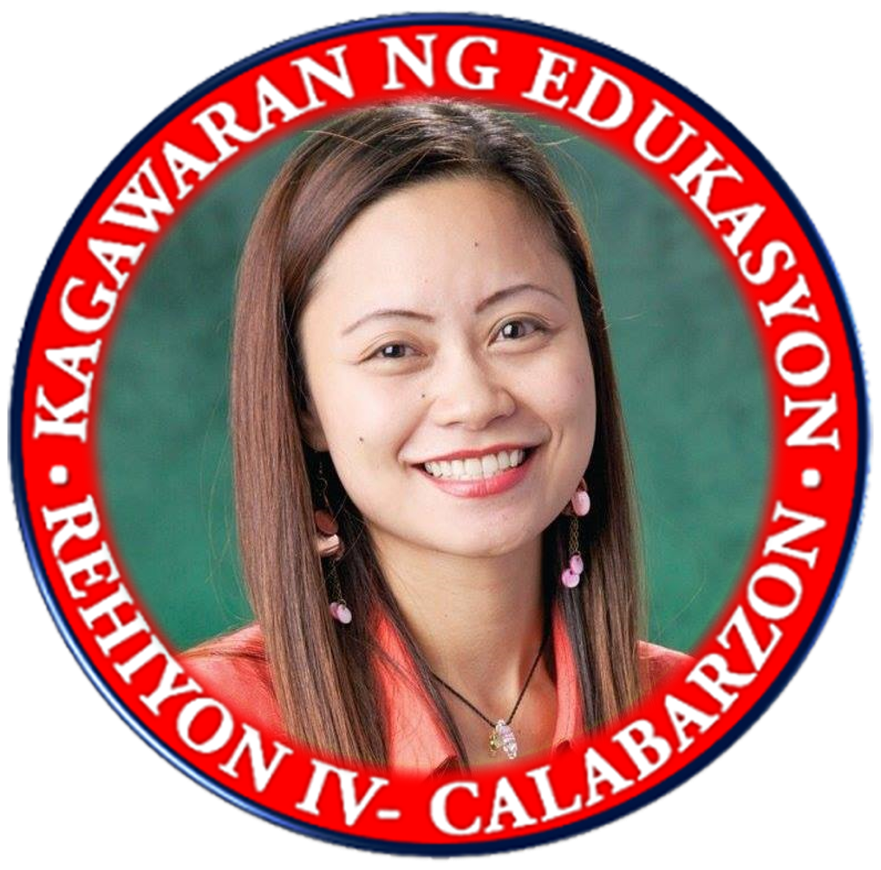

Planner
Week
MAAM LARISEL
1
2
3
4
Month
Year

Slide 2
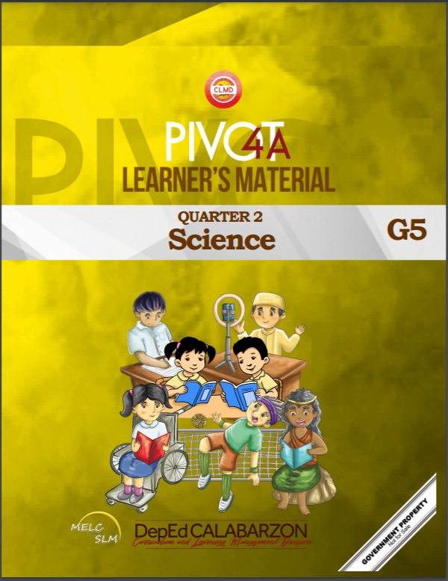

SCIENCE 5
Weekly Home Learning Plan
QUARTER 2 WEEK 1 & 2

Slide 3

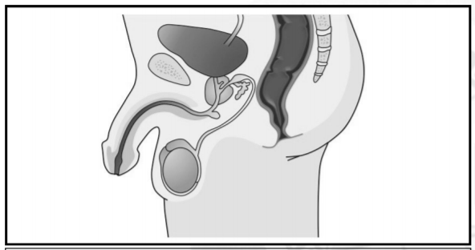
Republic of the Philippines
Department of Education
REGION IV-A
SCHOOLS DIVISION OFFICE OF IMUS CITY
NAME OF SCHOOL
WEEKLY HOME LEARNING PLAN
Grade and Section: _______________ Quarter 2 Week 1 & 2
Adviser: ________________________ Date: _______________
Monday to Friday | Learning Area | Learning Competency | Learning Tasks | Mode of Delivery
8:00-8:45 | SCIENCE | Describe the parts of the reproductive system and their functions S5LT-IIa1 | Human Reproductive System Learning Task 1: Study the two pictures below. Identify if it is a male or female reproductive system. Write your answer on a separate answer sheet. p.7 | * Track student progress in each task by Google Classroom. * Provide clear learning instructions.

Slide 4
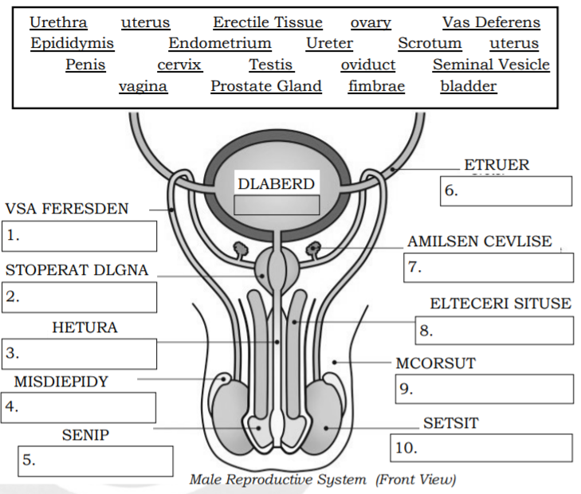
Monday to Friday | Learning Area | Learning Competency | Learning Tasks | Mode of Delivery
 |  |  | Learning Task 2: Identify the parts of a male reproductive organ based on the jumbled letters. You can also choose the word from the box. Before choosing the word, encircle all the parts of male & female reproductive system. p.8 | * Track student progress in each task by Google Classroom. * Provide clear learning instructions.

Slide 5
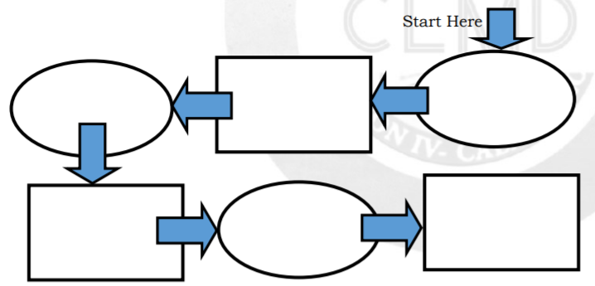
Monday to Friday | Learning Area | Learning Competency | Learning Tasks | Mode of Delivery
 |  |  | Learning Task 3: Fill in the boxes of the flowchart with correct word showing how the semen is released from the male reproductive system. p.9 Learning Task 4: Fill in the boxes of flow chart with correct word (part of the female reproductive system) showing how egg matures and being fertilized in the presence of sperm cell or goes out of the body in the form of blood. p.10 | * Track student progress in each task by Google Classroom. * Provide clear learning instructions.

Slide 6
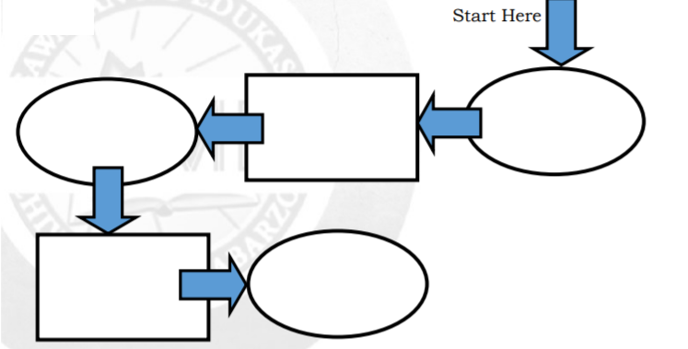
Monday to Friday | Learning Area | Learning Competency | Learning Tasks | Mode of Delivery
 |  |  | Learning Task 5: Write MR if the given word is a part of the male reproductive system. Otherwise, write FR. In case the part can be found in both system, write BOTH. p.11 ______ 1. Urethra ______ 2. Uterus ______3. Erectile Tissue _____ 4.Ovary ______5. Vas Deferens _____ 6. Epididymis | * Track student progress in each task by Google Classroom. * Provide clear learning instructions.

Slide 7
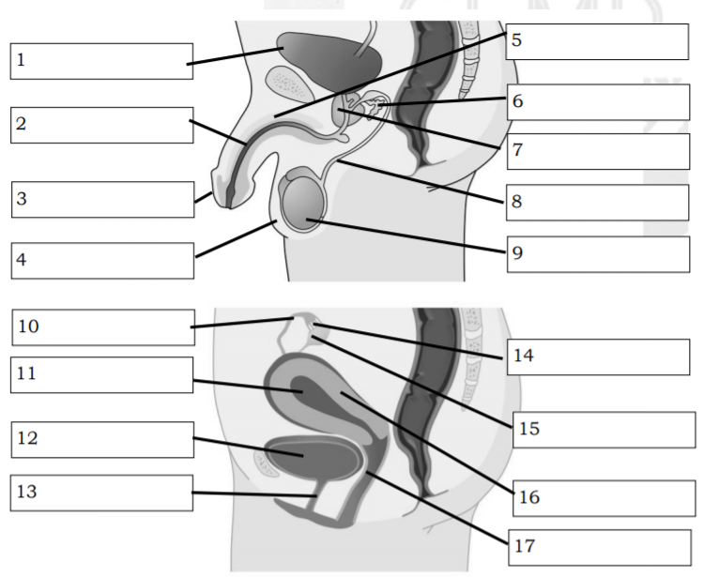
Monday to Friday | Learning Area | Learning Competency | Learning Tasks | Mode of Delivery
 |  |  | Learning Task 6: Label the parts of the male and female reproductive system. Draw both pictures in hour notebook. p.11 | * Track student progress in each task by Google Classroom. * Provide clear learning instructions.

Slide 8
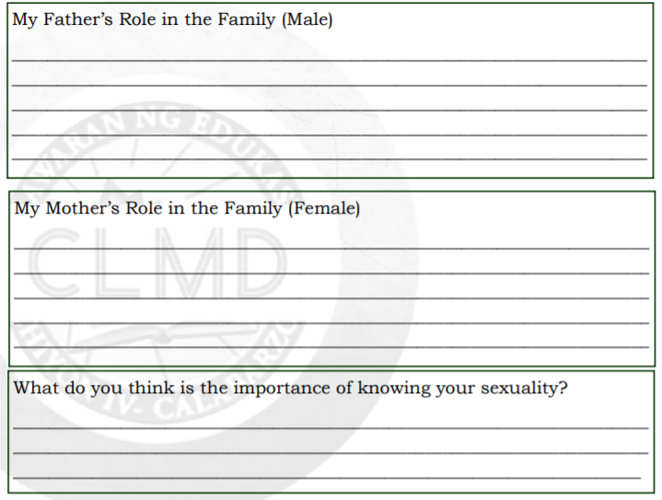
Monday to Friday | Learning Area | Learning Competency | Learning Tasks | Mode of Delivery
 |  |  | Learning Task 7: Both males and females have roles in the community. These roles are observable in your parents especially in your father and your mother. Complete the boxes below to describe the roles of your parents in your family. p.12 | * Track student progress in each task by Google Classroom. * Provide clear learning instructions.

Slide 9
SCIENCE 5
Weekly Home Learning Plan
QUARTER 2 WEEK 3

Slide 10
Republic of the Philippines
Department of Education
REGION IV-A
SCHOOLS DIVISION OFFICE OF IMUS CITY
NAME OF SCHOOL
WEEKLY HOME LEARNING PLAN
Grade and Section: _______________ Quarter 2 Week 3
Adviser: ________________________ Date: _______________
Monday to Friday | Learning Area | Learning Competency | Learning Tasks | Mode of Delivery
8:00-8:45 | SCIENCE | Explain the menstrual cycle S5LT-IIc3 | Menstrual Cycle Learning Task 1: Conduct an interview with your older sisters or mother about their menstruation. Be guided with the interview questions below: p.14 At what age did you first experience to have menstruation or period? ___________________________________ For this month, at what exact date do you usually start experiencing bleeding? ___________________________________ | * Track student progress in each task by Google Classroom. * Provide clear learning instructions.

Slide 11
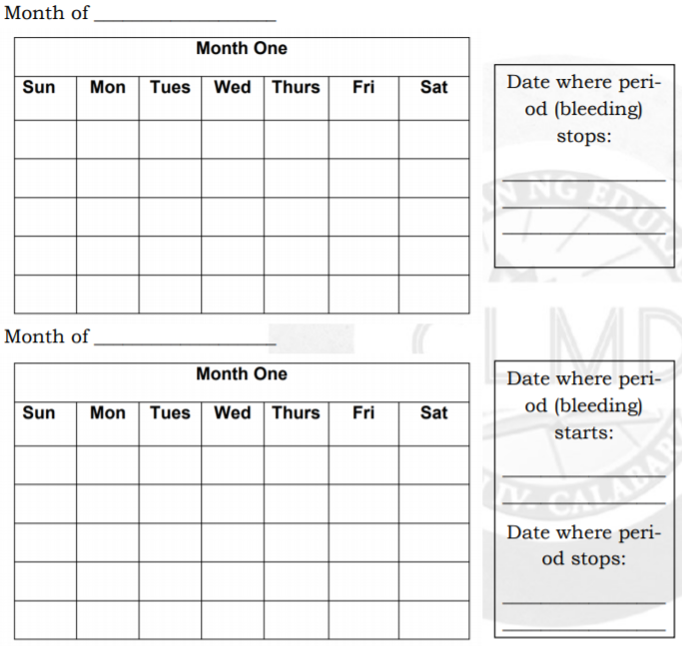
Monday to Friday | Learning Area | Learning Competency | Learning Tasks | Mode of Delivery
 |  |  | Learning Task 2: Pick a date in a calendar. Consider that date as the first day of the menstrual cycle. Indicate also in the calendar the last day of the menstrual cycle. Accomplish the calendar in your notebook. p.15 | * Track student progress in each task by Google Classroom. * Provide clear learning instructions.

Slide 12
Monday to Friday | Learning Area | Learning Competency | Learning Tasks | Mode of Delivery
 |  |  | Learning Task 3: Determine whether the statement is TRUE or FALSE. Write WOMAN if the statement expressed true idea. Otherwise, write MAN if it is false. p.16 ________ 1. Menstrual cycle period may change every month. ________ 2. The blood from menstruation is filthy. ________ 3. The blood during menstruation is due to crashed egg cells. I understand that _________________________________ _____________________________________________________________________________________________________________________ | * Track student progress in each task by Google Classroom. * Provide clear learning instructions.

Slide 13
SCIENCE 5
Weekly Home Learning Plan
QUARTER 2 WEEK 4

Slide 14
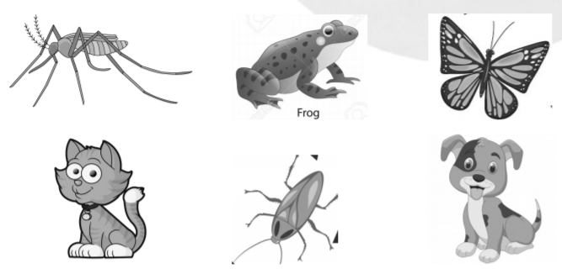
Republic of the Philippines
Department of Education
REGION IV-A
SCHOOLS DIVISION OFFICE OF IMUS CITY
NAME OF SCHOOL
WEEKLY HOME LEARNING PLAN
Grade and Section: _______________ Quarter 2 Week 4
Adviser: ________________________ Date: _______________
Monday to Friday | Learning Area | Learning Competency | Learning Tasks | Mode of Delivery
8:00-8:45 | SCIENCE | Describe the different modes of reproduction in animals such as butterflies, mosquitoes, frogs, cats and dogs S5LT-IIe5 | Modes of Reproduction in Animals Learning Task 1: Encircle the animals that can reproduce in large number. p.17 What are the animals that can reproduce in large number? __________ | * Track student progress in each task by Google Classroom. * Provide clear learning instructions.

Slide 15
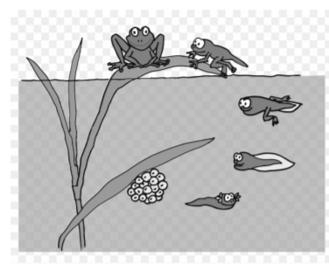
Monday to Friday | Learning Area | Learning Competency | Learning Tasks | Mode of Delivery
 |  |  | Learning Task 2: Identify whether the following animals are reproducing sexually. Write TWO PARENTS if the animal shows sexual reproduction. Otherwise, write SINGLE PARENT. p.18 ________ 1. dolphin ________ 2. sea anemone ________ 3. housefly ________ 4. earthworm ________ 5. starfish Learning Task 3: Study the figures below. The first picture shows a frog in its natural environment. The second picture shows a pregnant dog. p.18 | * Track student progress in each task by Google Classroom. * Provide clear learning instructions.

Slide 16
Monday to Friday | Learning Area | Learning Competency | Learning Tasks | Mode of Delivery
 |  |  | Learning Task 4: Think of two animals that can reproduce sexually. In the first box, draw an example of an animal that exhibits internal fertilization (fertilization occurs inside the body) . In the second box, draw an animal that exhibits external fertilization (fertilization occurs outside the body or in the outside environment). p.19 | * Track student progress in each task by Google Classroom. * Provide clear learning instructions.

Slide 17
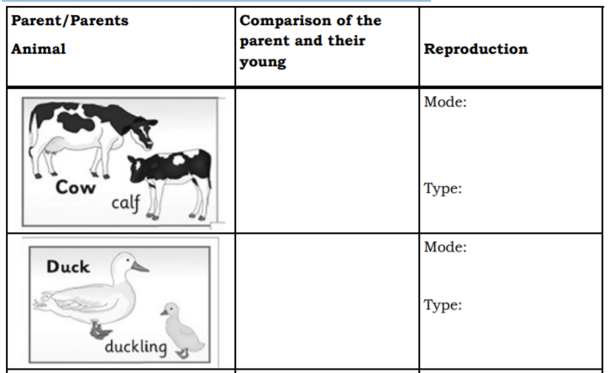
Monday to Friday | Learning Area | Learning Competency | Learning Tasks | Mode of Delivery
 |  |  | Learning Task 5: Study each picture in Column 1 . Each picture shows the parent animal and its offspring. Complete Column 2 by comparing the parent animal and its young and Column 3 by describing their mode and type of reproduction. Copy the chart in your notebook. p.21 | * Track student progress in each task by Google Classroom. * Provide clear learning instructions.

Slide 18
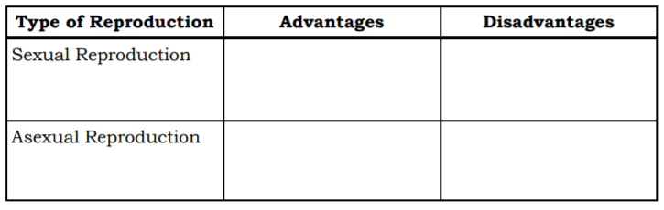
Monday to Friday | Learning Area | Learning Competency | Learning Tasks | Mode of Delivery
 |  |  | Learning Task 6: Based on what you have learned in this lesson, indicate the advantages and disadvantages of sexual and asexual reproduction in animals. You may use books and other references for your answers. p.22 | * Track student progress in each task by Google Classroom. * Provide clear learning instructions.

Slide 19
SCIENCE 5
Weekly Home Learning Plan
QUARTER 2 WEEK 5

Slide 20
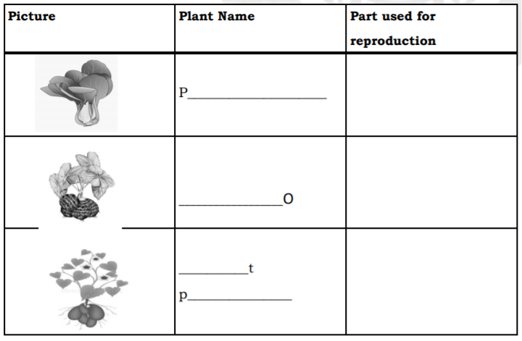
Republic of the Philippines
Department of Education
REGION IV-A
SCHOOLS DIVISION OFFICE OF IMUS CITY
NAME OF SCHOOL
WEEKLY HOME LEARNING PLAN
Grade and Section: _______________ Quarter 2 Week 5
Adviser: ________________________ Date: _______________
Monday to Friday | Learning Area | Learning Competency | Learning Tasks | Mode of Delivery
8:00-8:45 | SCIENCE | Describe the reproductive parts in plants and their functions S5LT -IIf – 6 | Reproductive System in Plants Learning Task 1: Study the pictures. Name the plant. Identify the part of the plants used for reproduction. p.23 | * Track student progress in each task by Google Classroom. * Provide clear learning instructions.

Slide 21
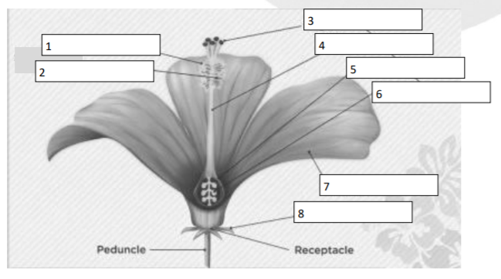
Monday to Friday | Learning Area | Learning Competency | Learning Tasks | Mode of Delivery
 |  |  | Learning Task 2: All plants that bear flowers are called flowering plants. Flowers are useful in the process of fertilization among plants. Below is a figure showing the parts of a flower involve in fertilization. Study the figure and label the parts of a flower. Copy this in your notebook. p.25 | * Track student progress in each task by Google Classroom. * Provide clear learning instructions.

Slide 22
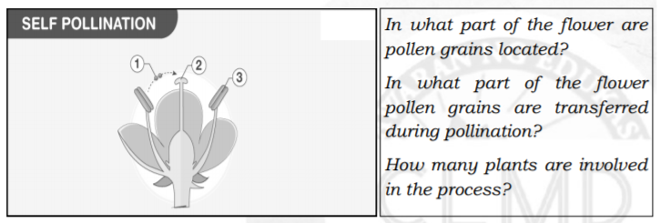
Monday to Friday | Learning Area | Learning Competency | Learning Tasks | Mode of Delivery
 |  |  | Learning Task 3: Compare and contrast the two types of pollination Use the illustrations to answer the questions found in the boxes . p.27 Learning Task 4: Name 3 plants . Identify the pollinators by completing the chart below. Illustrate how pollination takes place in each flower. Draw this in your notebook. p.28 | * Track student progress in each task by Google Classroom. * Provide clear learning instructions.
Agent of Pollination/Pollinator | Drawing

Slide 23
SCIENCE 5
Weekly Home Learning Plan
QUARTER 2 WEEK 6

Slide 24
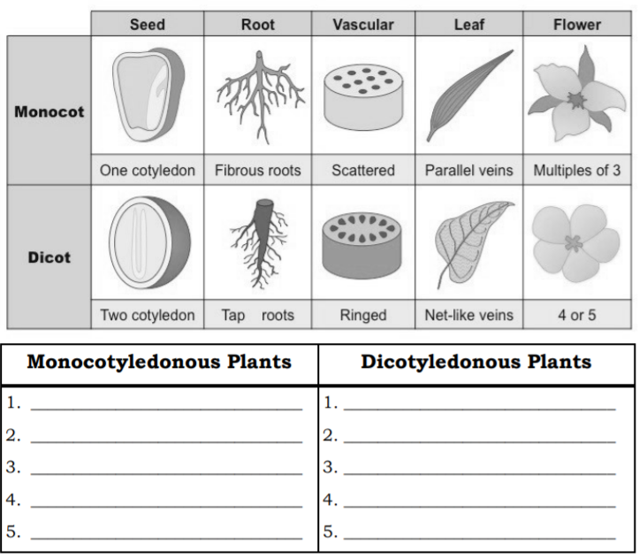
Republic of the Philippines
Department of Education
REGION IV-A
SCHOOLS DIVISION OFFICE OF IMUS CITY
NAME OF SCHOOL
WEEKLY HOME LEARNING PLAN
Grade and Section: _______________ Quarter 2 Week 6
Adviser: ________________________ Date: _______________
Monday to Friday | Learning Area | Learning Competency | Learning Tasks | Mode of Delivery
8:00-8:45 | SCIENCE | Describe the different modes of reproduction in flowering and non - flowering plants \ such as moss, fern, mongo and others S5LT -IIg - 7 | Modes of Reproduction in Plants Learning Task 1: Observe your surrounding. List down the plants that possess the given description below on monocot and dicot. p.30 | * Track student progress in each task by Google Classroom. * Provide clear learning instructions.

Slide 25
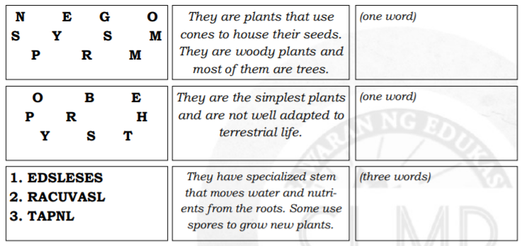
Monday to Friday | Learning Area | Learning Competency | Learning Tasks | Mode of Delivery
 |  |  | Learning Task 2: There are nonflowering plants that do not produce flowers and seeds. There are plants that produce spores . There are plants where seeds are not developed inside the parts of the flowers . In this activity, try to re arranged the jumbled letters to know these plants. p.31 | * Track student progress in each task by Google Classroom. * Provide clear learning instructions.

Slide 26
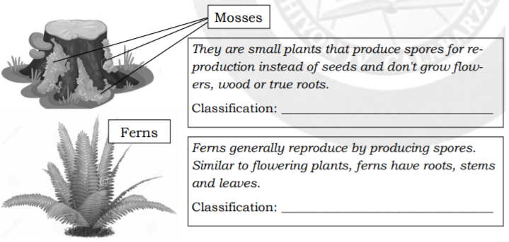
Monday to Friday | Learning Area | Learning Competency | Learning Tasks | Mode of Delivery
 |  |  | Learning Task 3: Based on the given description, identify the classification of the plants found on the left side of each description. p.31 Learning Task 4: Given the chart , put a check mark if each characteristic is true to each group of plants. p.32 | * Track student progress in each task by Google Classroom. * Provide clear learning instructions.

Slide 27
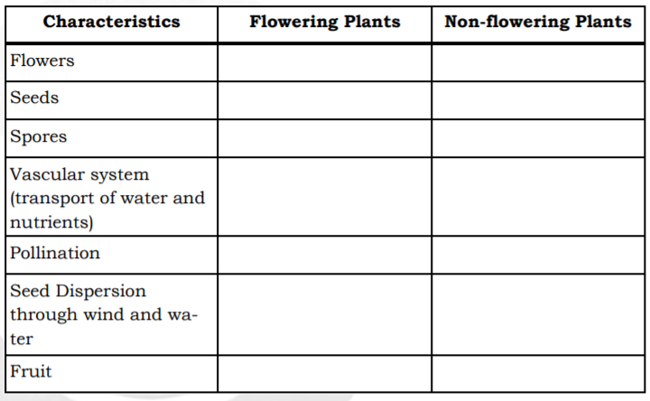
Monday to Friday | Learning Area | Learning Competency | Learning Tasks | Mode of Delivery
 |  |  | Learning Task 5: A herbarium is an album or scrapbook of compressed flowering nonflowering plants. It may contain all parts or some parts of plants. To make a herbarium, follow the following steps : p.32 1. Collect plants or plant parts. Compress using an old book or any material where you can platen the parts. | * Track student progress in each task by Google Classroom. * Provide clear learning instructions.

Slide 28
SCIENCE 5
Weekly Home Learning Plan
QUARTER 2 WEEK 7

Slide 29
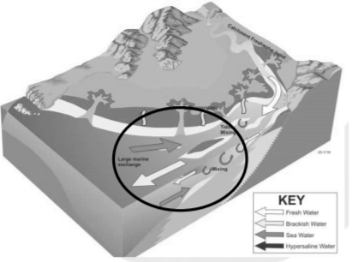
Republic of the Philippines
Department of Education
REGION IV-A
SCHOOLS DIVISION OFFICE OF IMUS CITY
NAME OF SCHOOL
WEEKLY HOME LEARNING PLAN
Grade and Section: _______________ Quarter 2 Week 7
Adviser: ________________________ Date: _______________
Monday to Friday | Learning Area | Learning Competency | Learning Tasks | Mode of Delivery
8:00-8:45 | SCIENCE | Discuss the interactions among living things and non -living things in estuaries and intertidal zones S5LT - IIh - 8 | Interactions in Estuaries and Intertidal Zones Learning Task 1: Organisms require energy to perform life activities. In this case, they need to eat food. Analyze the figure (left side). Observe the pattern how organisms interact and get energy (eating). Fill in the blanks below based on the figure. p.33 | * Track student progress in each task by Google Classroom. * Provide clear learning instructions.

Slide 30
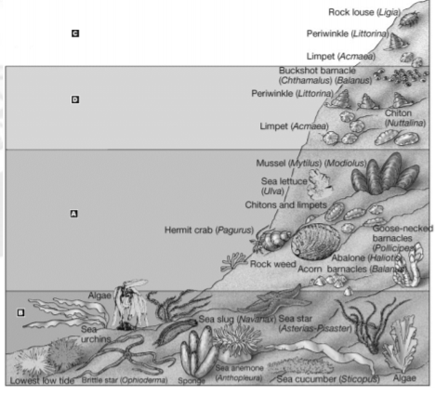
Monday to Friday | Learning Area | Learning Competency | Learning Tasks | Mode of Delivery
 |  |  | Learning Task 2: Just like in estuaries, organisms in intertidal zones need energy to live through eating food. Analyze the figure (right side). Observe the different organisms and imagine how they interact and get energy (eating). Fill in the blanks below based on the figure. Note: answer may not be in the illustration. p.34 1. Hermit crab eats ________________________ | * Track student progress in each task by Google Classroom. * Provide clear learning instructions.

Slide 31
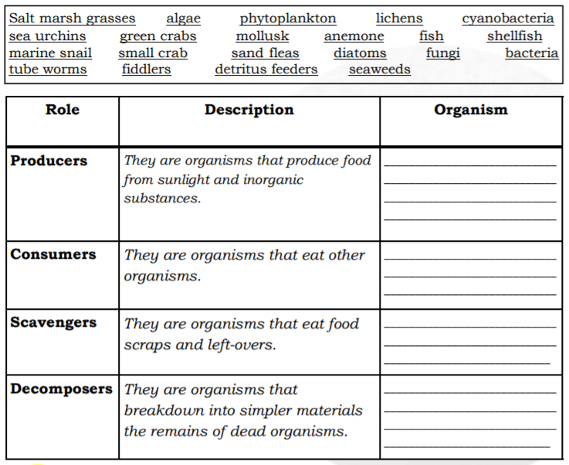
Monday to Friday | Learning Area | Learning Competency | Learning Tasks | Mode of Delivery
 |  |  | Learning Task 3: In both estuary and intertidal zone, organisms have different roles to perform. In this task, identify the organisms that perform the given roles. Choose the word/ group of words in the box. p.35 | * Track student progress in each task by Google Classroom. * Provide clear learning instructions.

Slide 32
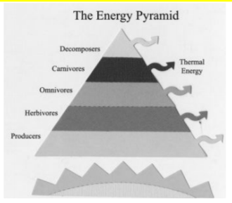
Monday to Friday | Learning Area | Learning Competency | Learning Tasks | Mode of Delivery
 |  |  | Learning Task 4. Make a model of ecological (energy) pyramid showing the arrangement of producers, consumers, scavengers and decomposers. You may include the organisms that you answer in Learning Task 3. You may use scrap materials in making the 3D model of ecological pyramid. The figure below gives you the idea of the content of the pyramid. You may ask your teacher for the rubric of the activity. p.35 | * Track student progress in each task by Google Classroom. * Provide clear learning instructions.

Slide 33
SCIENCE 5
Weekly Home Learning Plan
QUARTER 2 WEEK 8

Slide 34
Republic of the Philippines
Department of Education
REGION IV-A
SCHOOLS DIVISION OFFICE OF IMUS CITY
NAME OF SCHOOL
WEEKLY HOME LEARNING PLAN
Grade and Section: _______________ Quarter 2 Week 8
Adviser: ________________________ Date: _______________
Monday to Friday | Learning Area | Learning Competency | Learning Tasks | Mode of Delivery
8:00-8:45 | SCIENCE | Explain the need to protect and conserve estuaries and intertidal zones S5LT -Ii - j -10 | The Need to Protect and Conserve Estuaries and Intertidal Zones Learning Task 1: Draw a smiley face on the action or activity that helps protect and conserve the estuaries and intertidal zones. p.36 _______ 1. planting trees _______ 2. disposing garbage properly _______ 3. restricting fishing activities _______ 4. banning recreational birding _______ 5. avoiding oil leaks | * Track student progress in each task by Google Classroom. * Provide clear learning instructions.

Slide 35
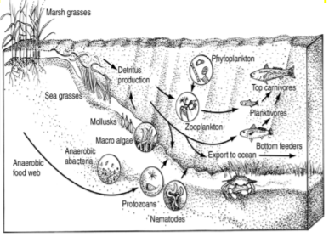
Monday to Friday | Learning Area | Learning Competency | Learning Tasks | Mode of Delivery
 |  |  | Learning Task 2: The diagram shows both food chain and food web in estuaries. Food chain is a series of transfer of energy as the algae can be eaten by small fish and small fish may be eaten by a carnivorous fish. A food web is composed of different food chains. What do you think are the activities that may negatively affect the process of energy transfer? p.36 | * Track student progress in each task by Google Classroom. * Provide clear learning instructions.

Slide 36

Monday to Friday | Learning Area | Learning Competency | Learning Tasks | Mode of Delivery
 |  |  | Learning Task 4: Now that you k no w t he im p o r t a nc e o f estuaries and intertidal zones, as student you can do your part in protecting and conserving them. To show your support to the program entitled " Save Manila Bay", in a bond paper, make a poster in indicating your proposed actions in cooperation and collaboration with your classmates. p.36 | * Track student progress in each task by Google Classroom. * Provide clear learning instructions.

Slide 37
Thanks!
Do you have any questions?
titserlarisel@gmail.com
Planner
Week
1
2
3
4
Month
MAAM LARISEL
Year

