Slide 1
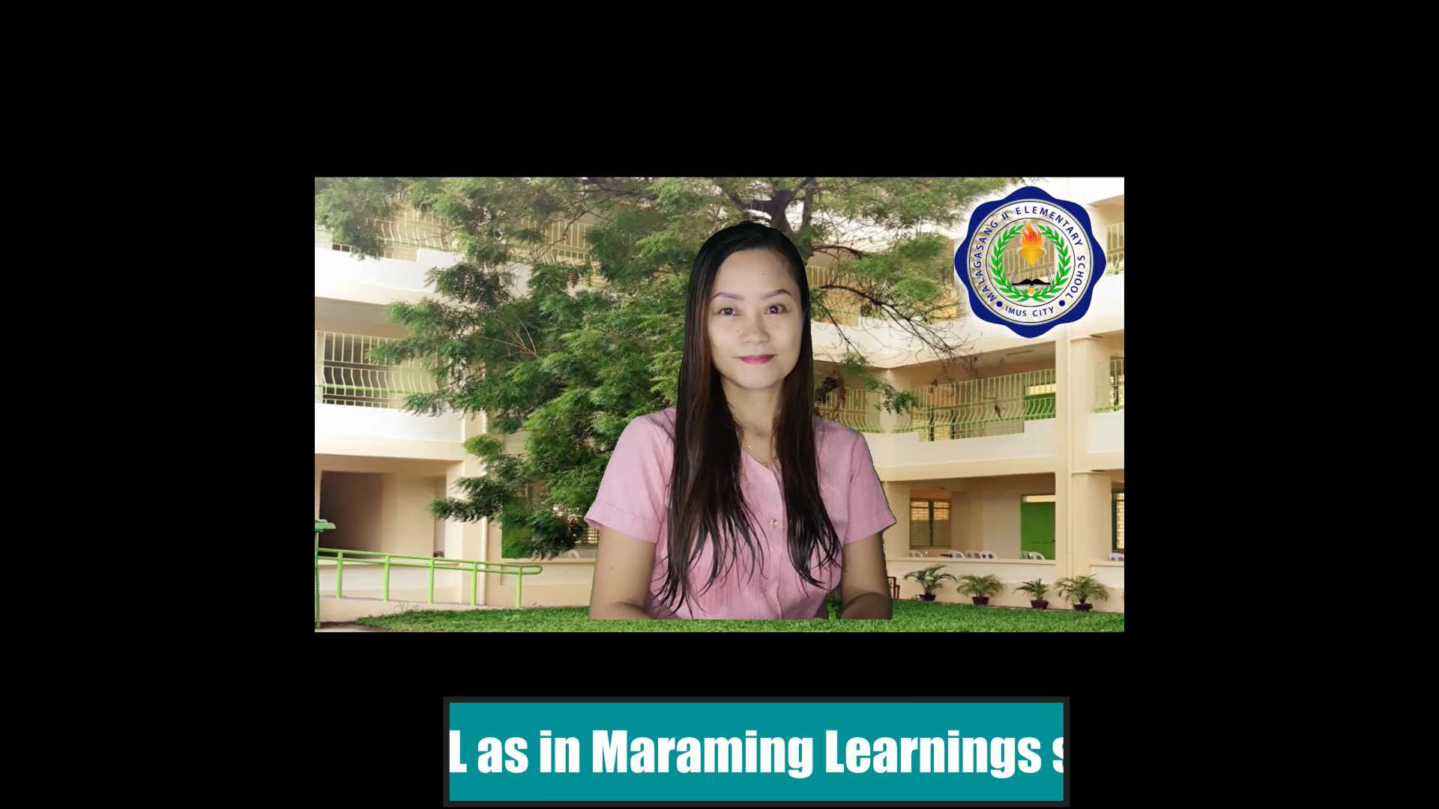


MAAM LARISEL

Slide 2
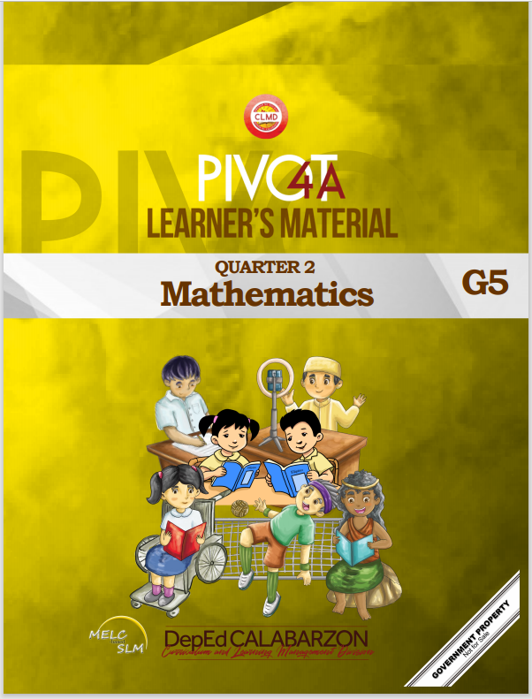

MATH 5
WEEKLY HOME LEARNING PLAN
QUARTER 2
WEEK 1

Slide 3

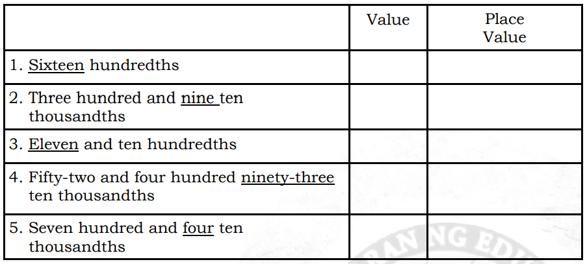
Republic of the Philippines
Department of Education
REGION IV-A
SCHOOLS DIVISION OFFICE OF IMUS CITY
NAME OF SCHOOL
WEEKLY HOME LEARNING PLAN
Grade and Section: _______________ Quarter 2 Week 1
Adviser: ________________________ Date:__________
Monday to Friday | Learning Area | Learning Competency | Learning Tasks | Mode of Delivery
8:00-8:45 | MATH | Gives the place value and the value of a digit of a given decimal number through ten thousandths. M5NS – Iia - 101.2 | Place Value and the Value of a Digit of a Given Decimal Number Through Ten Thousandths Learning Task 1: Give the value and the place value of the underlined digits. Write your answers in your notebook. p.7 | * Track student progress in each task by Google Classroom. * Provide clear learning instructions.

Slide 4
Monday to Friday | Learning Area | Learning Competency | Learning Tasks | Mode of Delivery
 |  |  | Learning Task 2: Give the place value of the underlined digits. Write your answers in your notebook. p.7 1. 2.284 2. 2.6853 3. 3.1763 4. 19.0365 5. 0.0128 6. 0.827 Learning Task 3: Write the place value of the digit 6 in each number. Write your answers in your notebook. p.7 29.376 2. 46.801 3. 67.8012 4. 0.2356 5. 86. 047 6. 481.671 | * Track student progress in each task by Google Classroom. * Provide clear learning instructions.

Slide 5
Monday to Friday | Learning Area | Learning Competency | Learning Tasks | Mode of Delivery
 |  |  | Learning Task 4: In 50 678.39241, identify the digits indicated below. Write your answers in your notebook. p.7 Hundreds place - ______ 2. Thousandths place - ______ 3. Tenths place - ______ 4. Ten thousandths place- ______ 5. Hundredths place - ______ | * Track student progress in each task by Google Classroom. * Provide clear learning instructions.

Slide 6
Monday to Friday | Learning Area | Learning Competency | Learning Tasks | Mode of Delivery
 |  | Reads and writes decimal numbers through ten thousandths. M5NS – Iia - 102.2 | Decimal Numbers through Ten Thousandths Learning Task 1: Write the decimal form of each item below. Do this in your notebook. p.8 1. Three hundred forty-two ten thousandths 2. Five and thirty-eight thousandths 3. Seventy-six and two tenths 4. One hundred and twenty-seven thousandths 5. Nine hundred sixteen and twelve ten thousandths Learning Task 2: Write the given numbers in words. Write your answers in your notebook. p.9 32.061 2. 10.8209 | * Track student progress in each task by Google Classroom. * Provide clear learning instructions.

Slide 7
Monday to Friday | Learning Area | Learning Competency | Learning Tasks | Mode of Delivery
 |  |  | Learning Task 3: Write the given fractions in decimals. Write your answers in your notebook. p.9 123 100 2. 3 10 3. 5143 1000 Learning Task 4: Read and answer the given problems. Write your answers in your notebook. p.9 1. The distance between the playground and your house is one and eighty thousandths kilometers. Write the distance in its decimal form. | * Track student progress in each task by Google Classroom. * Provide clear learning instructions.

Slide 8
MATH 5
WEEKLY HOME LEARNING PLAN
QUARTER 2
WEEK 2

Slide 9
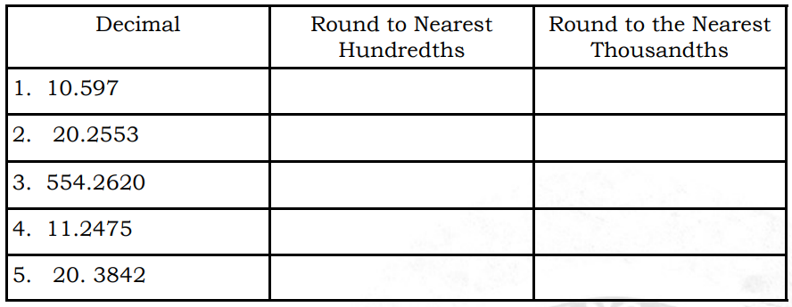
Republic of the Philippines
Department of Education
REGION IV-A
SCHOOLS DIVISION OFFICE OF IMUS CITY
NAME OF SCHOOL
WEEKLY HOME LEARNING PLAN
Grade and Section: _______________ Quarter 2 Week 2
Adviser: ________________________ Date:__________
Monday to Friday | Learning Area | Learning Competency | Learning Tasks | Mode of Delivery
8:00-8:45 | MATH | Rounds decimal numbers to the nearest hundredth and thousandth. M5NS - Iia - 103.2 | Rounding Decimal Numbers to the Nearest Hundredths and Thousandths Learning Task 1: Copy the table below in your notebook. Then, round each item to the nearest hundredths and thousands. p.7 | * Track student progress in each task by Google Classroom. * Provide clear learning instructions.

Slide 10
Monday to Friday | Learning Area | Learning Competency | Learning Tasks | Mode of Delivery
 |  |  | Learning Task 2: Get the quotient of each item up to the nearest ten thousandths place. Then, round the decimals to their nearest thousandths. Number 1 is done for you. p.11 1. 45 ÷ 8 = 5.6250 5.625 2. 77 ÷ 9 = _______ _____ 3. 81 ÷ 7 = _______ _____ Learning Task 3: Solve the given problems below. Write your answers in your notebook. p.11 What is the smallest decimal in hundredths rounded to 0.5? What is the largest decimal in hundredths rounded to 0.5? | * Track student progress in each task by Google Classroom. * Provide clear learning instructions.

Slide 11
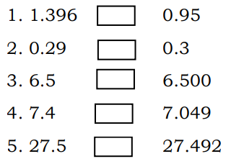
Monday to Friday | Learning Area | Learning Competency | Learning Tasks | Mode of Delivery
 |  | Compares and arranges decimal numbers. M5NS - Iib - 104.2 | Comparison and Arrangement of Decimal Numbers Learning Task 1: Compare the following decimals by writing >, <, or =. Do this in your notebook. p.13 Learning Task 3: Solve the given problems. Write your answers in your notebook. p.13 | * Track student progress in each task by Google Classroom. * Provide clear learning instructions.

Slide 12
Monday to Friday | Learning Area | Learning Competency | Learning Tasks | Mode of Delivery
 |  |  | Team Narra and Team Mahogany underwent a water challenge. Their task was to transfer the water in a cup from the first player to the tenth player without spilling within the allotted time. After the task, the team captain measured the water collected using a measuring cup. Team Narra collected 1. 402 liters while Team Mahogany collected 1. 045 liters of water. Which team got more water? In a bazaar, different items were on sale for big discounts. Irene was looking for a school bag. She visited three stalls to buy one for his younger brother. The stall offered the school bag of the same quality but differed in price. The first stall offered it for P 749. 25, the second stall for P 792.45 and the third stall for P 724. 95. If she wanted to save, from which stall would she buy the school bag? | * Track student progress in each task by Google Classroom. * Provide clear learning instructions.

Slide 13
MATH 5
WEEKLY HOME LEARNING PLAN
QUARTER 2
WEEK 3

Slide 14
Republic of the Philippines
Department of Education
REGION IV-A
SCHOOLS DIVISION OFFICE OF IMUS CITY
NAME OF SCHOOL
WEEKLY HOME LEARNING PLAN
Grade and Section: _______________ Quarter 2 Week 3
Adviser: ________________________ Date:__________
Monday to Friday | Learning Area | Learning Competency | Learning Tasks | Mode of Delivery
8:00-8:45 | MATH | Solves routine or non -routine problems involving addition and subtraction of decimal numbers including money using appropriate problem solving strategies and tools. M5NS – Iic - 108.1 | Routine or Non-Routine Problems Involving Addition and Subtraction of Decimal Numbers Including Money Learning Task 1: Find the sum of the given decimals. Write your answers in your notebook. p.14 23.45 + 8.63 + 2.75 8.05 + 7.93 + 1.62 112.56 + 23.63 + 12.45 | * Track student progress in each task by Google Classroom. * Provide clear learning instructions.

Slide 15
Monday to Friday | Learning Area | Learning Competency | Learning Tasks | Mode of Delivery
 |  |  | Learning Task 2: Solve the following problems. Write your answers in your notebook. p.15 The perimeter of a quadrilateral is 412.95 cm. If the three known sides measure 85.56 cm, 112.77 cm, and 85.26 cm, how long is the fourth side? Learning Task 3: Read and solve the following problems. Write your answers in your notebook. p.15 The diameter of the Earth is 12 763.29 kilometers. If Mercury’s diameter is about 7 913.04 kilometers shorter than that of the Earth, what is the diameter of Mercury? | * Track student progress in each task by Google Classroom. * Provide clear learning instructions.

Slide 16
Monday to Friday | Learning Area | Learning Competency | Learning Tasks | Mode of Delivery
 |  |  | Learning Task 4. Solve the given problems. Write your answers in your notebook. p.15 Dana filled the container with 3.5 liters of water. Her mother used 0.75 liters of water for cooking and 1.25 liters for palamig. How much water was left in the container? | * Track student progress in each task by Google Classroom. * Provide clear learning instructions.

Slide 17
MATH 5
WEEKLY HOME LEARNING PLAN
QUARTER 2
WEEK 4

Slide 18
Republic of the Philippines
Department of Education
REGION IV-A
SCHOOLS DIVISION OFFICE OF IMUS CITY
NAME OF SCHOOL
WEEKLY HOME LEARNING PLAN
Grade and Section: _______________ Quarter 2 Week 4
Adviser: ________________________ Date:__________
Monday to Friday | Learning Area | Learning Competency | Learning Tasks | Mode of Delivery
8:00-8:45 | MATH | Multiplies decimals up to 2 decimal places by 1 - to 2 - digit whole numbers. M5NS - IId - 111.1 | Multiplication of Decimals Up to 2 Decimal Places by 1- to 2-Digit Whole Numbers Learning Task 1: Solve the following problems. Write your answers in your notebook. p.17 1. weight - 102 lbs , 3 hours , jumping rope 2. weight - 75 lbs , 1.5 hours , house cleaning 3. weight - 105 lbs , 2.6 hours , running 4. weight - 117 lbs , 0.6 hours , swimming | * Track student progress in each task by Google Classroom. * Provide clear learning instructions.

Slide 19
Monday to Friday | Learning Area | Learning Competency | Learning Tasks | Mode of Delivery
 |  |  | Learning Task 2: Find the product. Write your answers in your notebook. p.17 4.29 2) 12.47 x 12 x3 Learning Task 3: Solve the given problems. Write your answers in your notebook. p.17 If a notebook costs ₱ 5.25, how much is the cost of 6 notebooks? A working student earns ₱ 25.50 per hour. How much does he earn in 4 hours? If he works 3 days a week, how much does he earn in a week? | * Track student progress in each task by Google Classroom. * Provide clear learning instructions.

Slide 20
Monday to Friday | Learning Area | Learning Competency | Learning Tasks | Mode of Delivery
 |  | Estimates the products of decimal numbers with reasonable results. M5NS - IIe -112 | Estimation of the Products of Decimal Numbers with Reasonable Results Learning Task 1: Estimate the peso equivalent of the following items. Write your answers in your notebook. p.18 Hongkong $ 154 Singapore $ 154 Brunei $ 154 Learning Task 2: Estimate each product. Write your answers in your notebook. p.19 42.6 x 37.2 = ________ 2. 99.2 x 48.5 = ________ 246.3 x 9.67 = ________ | * Track student progress in each task by Google Classroom. * Provide clear learning instructions.

Slide 21
Monday to Friday | Learning Area | Learning Competency | Learning Tasks | Mode of Delivery
 |  |  | Learning Task 3. Estimate each product. Write your answers in your notebook. p.19 The following are some items that you need to buy from a store: a pair of socks -₱20.95 handkerchief - ₱24.25 t-shirt - ₱119.50 shorts - ₱52.30 face towel - ₱8.75 Approximately, how much money must you have to be able to buy the following: three pairs of socks 2. two t-shirts 3. five face towels 4. seven handkerchiefs 5. three shorts | * Track student progress in each task by Google Classroom. * Provide clear learning instructions.

Slide 22
Monday to Friday | Learning Area | Learning Competency | Learning Tasks | Mode of Delivery
 |  |  | Learning Task 4: Read the problem then answer the questions that follow. Write your estimation by showing your solutions and answers in your notebook. p.19 Diego and other farmers harvested tomatoes for the barangay’s Gulayan Day. They were able to fill 56.5 kaings each weighing 18.75 kilograms. About how many kilograms of tomatoes were harvested for the Gulayan Day? If they would sell the tomatoes for ₱24.25 a kilo, a. by how much would they get for one kaing? b. by how much would they get for all the tomatoes? | * Track student progress in each task by Google Classroom. * Provide clear learning instructions.

Slide 23
MATH 5
WEEKLY HOME LEARNING PLAN
QUARTER 2
WEEK 5

Slide 24
Republic of the Philippines
Department of Education
REGION IV-A
SCHOOLS DIVISION OFFICE OF IMUS CITY
NAME OF SCHOOL
WEEKLY HOME LEARNING PLAN
Grade and Section: _______________ Quarter 2 Week 5
Adviser: ________________________ Date:__________
Monday to Friday | Learning Area | Learning Competency | Learning Tasks | Mode of Delivery
8:00-8:45 | MATH | Solves routine and non – routine problems involving multiplication without or with addition or subtraction of decimals and whole numbers including money using appropriate problem solving strategies and tools M5NS - IIe - 113.1 | Routine and Non-Routine Problems Involving Multiplication Without or With Addition or Subtraction of Decimals and Whole Numbers Including Money Learning Task 1: Solve the given problems. Write your answers in your notebook. p.21 Larry drinks an average of 6.48 glasses of water per day. About how many glasses of water will he drink in: | * Track student progress in each task by Google Classroom. * Provide clear learning instructions.

Slide 25
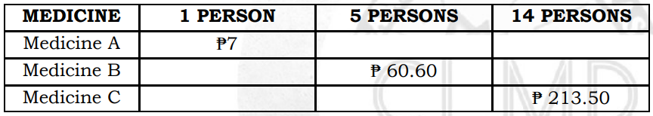
Monday to Friday | Learning Area | Learning Competency | Learning Tasks | Mode of Delivery
 |  |  | a week a month a year a decade Learning Task 2: Copy the table below. Write your answers in your notebook. p.21 Learning Task 3: Solve the following problems. Write your solutions and your answers in your notebook. | * Track student progress in each task by Google Classroom. * Provide clear learning instructions.

Slide 26
Monday to Friday | Learning Area | Learning Competency | Learning Tasks | Mode of Delivery
 |  |  | School lunches cost ₱35.50 per week. About how much would 15.5 weeks of lunches cost? Lorna earns ₱71.75 per hour for gardening. If she will work for 21 hours this month, then how much will she earn? Paul’s father will pay for his new car in 60-month payments. If his car loan costs ₱1,023,660, then how much will he pay for each month? The length of a ribbon is 1.28 m. The length of a rope is 2.74 m longer than the ribbon. What is the length of the rope? A pail holds 5.2 liters of water. A bottle holds 3.9 liters less water than the pail. What is the volume of water in the bottle? | * Track student progress in each task by Google Classroom. * Provide clear learning instructions.

Slide 27
MATH 5
WEEKLY HOME LEARNING PLAN
QUARTER 2
WEEK 6

Slide 28
Republic of the Philippines
Department of Education
REGION IV-A
SCHOOLS DIVISION OFFICE OF IMUS CITY
NAME OF SCHOOL
WEEKLY HOME LEARNING PLAN
Grade and Section: _______________ Quarter 2 Week 6
Adviser: ________________________ Date:__________
Monday to Friday | Learning Area | Learning Competency | Learning Tasks | Mode of Delivery
8:00-8:45 | MATH | Divides decimals with up to 2 decimal places. M5NS - IIf - 116.1 | Division of Decimals With Up to 2 Decimal Places Learning Task 1: Solve for n. Write your answer in your notebook. . p.22 7.26 x 0.22 = n 17.92 x 0.64 = n 7.65 x 0.85 = n 36.20 x 0.05 = n 31.85 x 0.91 = n | * Track student progress in each task by Google Classroom. * Provide clear learning instructions.

Slide 29
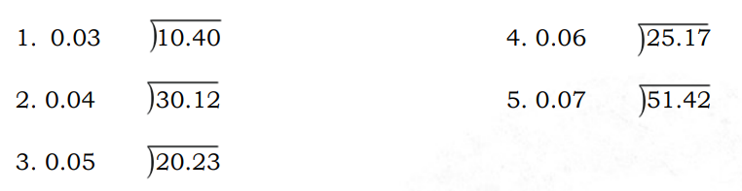
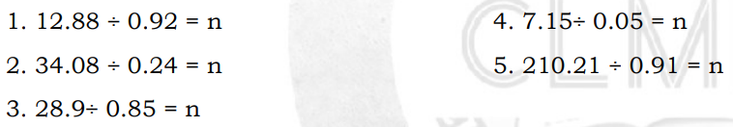
Monday to Friday | Learning Area | Learning Competency | Learning Tasks | Mode of Delivery
 |  |  | Learning Task 2: Find the quotient. Show how the decimal point is moved in the divisor and the dividend. Check by multiplication. Write your answers in your notebook. p.23 Learning Task 3: Solve for n. Write your answers in your notebook. p.23 | * Track student progress in each task by Google Classroom. * Provide clear learning instructions.

Slide 30
Monday to Friday | Learning Area | Learning Competency | Learning Tasks | Mode of Delivery
 |  |  | Learning Task 4: Solve the following problems. Write your solutions and your answers in you notebook. p.23 A nutritionist poured 0.70 liter of honey into 0.14 liter plastic cups. How many plastic cups could be filled? A rectangular rice field is 0.04 kilometer wide and has an area of 0.80 square kilometer. Find the length of the field. A city government plans to put streetlights along its 8.40-kilometer main road. The streetlights are to be placed 0.20 km apart. How many streetlights does the city government need? | * Track student progress in each task by Google Classroom. * Provide clear learning instructions.

Slide 31
Monday to Friday | Learning Area | Learning Competency | Learning Tasks | Mode of Delivery
 |  | Divides whole numbers with quotients in decimal form. M5NS - IIf - 116.2 | Division of Whole Numbers with Quotients in Decimal Form Learning Task 1: Find the quotient. Write your answers in your notebook. p.25 14 6 5 12 81 ÷ 0.08 Learning Task 2: Solve for n. Write your answer in your notebook. p.25 4 ÷ 80 = n 7 ÷ 14 = n | * Track student progress in each task by Google Classroom. * Provide clear learning instructions.

Slide 32
Monday to Friday | Learning Area | Learning Competency | Learning Tasks | Mode of Delivery
 |  |  | Learning Task 3: Solve the following problems. Write your solutions and your answers in you notebook. p.25 What is the quotient if 24 is divided by 48? Jean has 35 m of wire for hanging pictures. She wants to divide it into 50 pieces for her frames. How long will she use for each frame? Father left Php5.00 for his 7 children. How much did each child receive? | * Track student progress in each task by Google Classroom. * Provide clear learning instructions.

Slide 33
MATH 5
WEEKLY HOME LEARNING PLAN
QUARTER 2
WEEK 7

Slide 34
Republic of the Philippines
Department of Education
REGION IV-A
SCHOOLS DIVISION OFFICE OF IMUS CITY
NAME OF SCHOOL
WEEKLY HOME LEARNING PLAN
Grade and Section: _______________ Quarter 2 Week 7
Adviser: ________________________ Date:__________
Monday to Friday | Learning Area | Learning Competency | Learning Tasks | Mode of Delivery
8:00-8:45 | MATH | Solves routine and non – routine problems involving division without or with any of the other operations of decimals and whole numbers including money using appropriate problem solving strategies and tools. M5NS - IIg - 120.1 | Routine and Non-Routine Problems Involving Division Without or With Any of the Other Operations of Decimals and Whole Numbers Including Money Learning Task 1. Round off the items and estimate the quotients. Then, write ˂ if the answer is less than or ˃ if it is greater than the actual quotient. Do this in your notebook. p.26 28.4 ÷ 7 53.62 ÷ 5.24 | * Track student progress in each task by Google Classroom. * Provide clear learning instructions.

Slide 35
Monday to Friday | Learning Area | Learning Competency | Learning Tasks | Mode of Delivery
 |  |  | Learning Task 2: Solve the given problems below. Write your answers in your notebook. p.27 Dessa, Anne, and Dy bought materials for their project worth ₱276.45. The girls divided the amount equally among themselves. How much is each share? Learning Task 3: Solve the following problems. Show the four steps and the complete solutions. Write your answer in your notebook. p.27 1. Mr. Villa bought 91.25 inches of plastic labeling tape. He will use 1.25 inches long to label each. How many labels can he make? | * Track student progress in each task by Google Classroom. * Provide clear learning instructions.

Slide 36
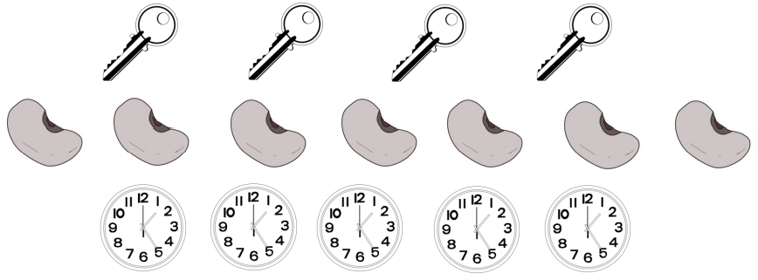
Monday to Friday | Learning Area | Learning Competency | Learning Tasks | Mode of Delivery
 |  | Visualizes the ratio of 2 given numbers. M5NS - IIh -122 | Learning Task 4: Solve the following problems. Write your solutions and your answers in you notebook. p.27 If a man works for 8 hours a day, he can finish a job in 12 days. How many hours per day must he work to complete it in 10 days? Ratio of 2 Given Numbers Learning Task 1: Based on the figures below, answer the given questions. Write your answers in your notebook. p.28 | * Track student progress in each task by Google Classroom. * Provide clear learning instructions.

Slide 37
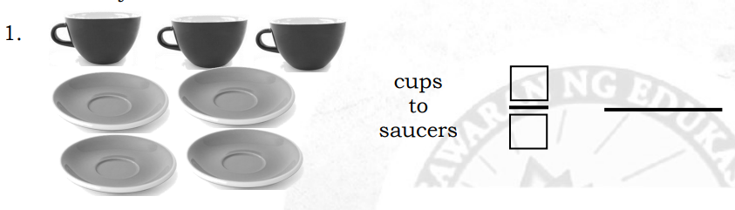
Monday to Friday | Learning Area | Learning Competency | Learning Tasks | Mode of Delivery
 |  |  | What is the ratio of keys to seeds? What is the ratio of clocks to seeds? What is the ratio of keys to clocks? What is the ratio of seeds to keys? What is the ratio of keys to all items? Learning Task 2: Write each ratio in fraction and colon forms. Write your answers in your notebook. p.29 Learning Task 3: Use the sets of pictures to answer the given questions. Write your answer in your notebook. p.29-30 | * Track student progress in each task by Google Classroom. * Provide clear learning instructions.

Slide 38
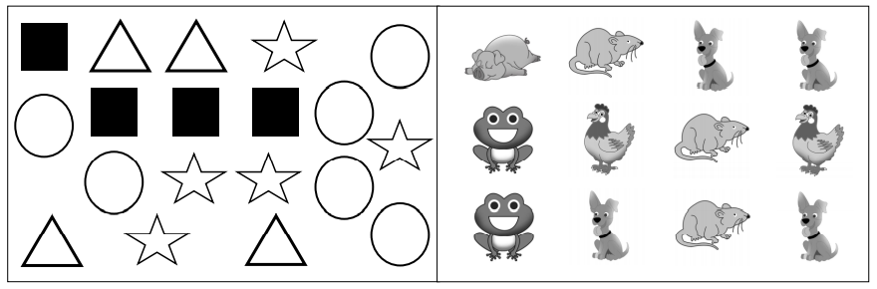
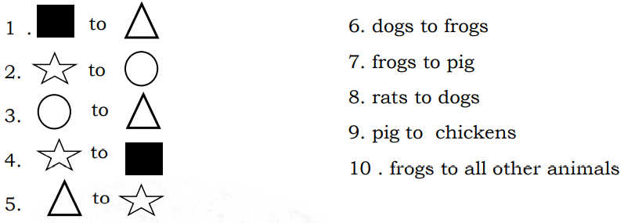
Monday to Friday | Learning Area | Learning Competency | Learning Tasks | Mode of Delivery
 |  |  | What is the ratio of the number of: | * Track student progress in each task by Google Classroom. * Provide clear learning instructions.

Slide 39
Monday to Friday | Learning Area | Learning Competency | Learning Tasks | Mode of Delivery
 |  |  | B. Draw any pictures showing the ratios of: 11. 3 to 4 12. 8 to 2 13. 10 to 5 14. 5 to 6 15. 2 to 6 Learning Task 4: Answer the given questions. Write your answers in your notebook. p. 30 What is the ratio of the number of vowels to the number of consonants in the English Alphabet? What is the ratio of the number of men to the number of women in the roster of Philippine Presidents? | * Track student progress in each task by Google Classroom. * Provide clear learning instructions.

Slide 40
MATH 5
WEEKLY HOME LEARNING PLAN
QUARTER 2
WEEK 8

Slide 41
Republic of the Philippines
Department of Education
REGION IV-A
SCHOOLS DIVISION OFFICE OF IMUS CITY
NAME OF SCHOOL
WEEKLY HOME LEARNING PLAN
Grade and Section: _______________ Quarter 2 Week 8
Adviser: ________________________ Date:__________
Monday to Friday | Learning Area | Learning Competency | Learning Tasks | Mode of Delivery
8:00-8:45 | MATH | Expresses ratios in their simplest forms. M5NS - IIi -125 | Ratio Using Either the Colon (:) or Fraction Learning Task 1: Express each ratio of the first quantity to the second quantity and reduce to its simplest form. Write your answers in your notebook. p. 32 2 teachers to 46 pupils 21 garbage cans to 14 classroom 36 glasses of juice to 30 sandwiches 12 flowers to 4 vases 4 books to 10 pupils | * Track student progress in each task by Google Classroom. * Provide clear learning instructions.

Slide 42
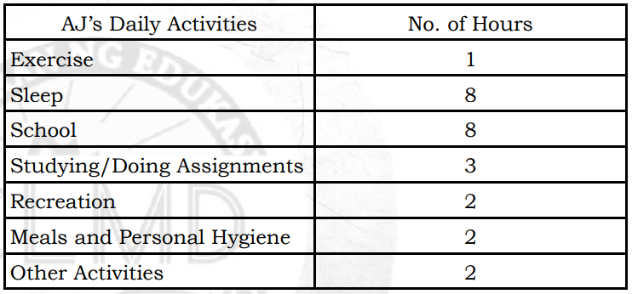
Monday to Friday | Learning Area | Learning Competency | Learning Tasks | Mode of Delivery
 |  |  | Learning Task 2: Find the ratios of the time spent for the different activities. Write your answers in your notebook. p. 32 sleeping to a whole day studying to the time for recreation Learning Task 3: Write the following ratios to lowest terms. Write your answers in your notebook. p. 32 | * Track student progress in each task by Google Classroom. * Provide clear learning instructions.

Slide 43
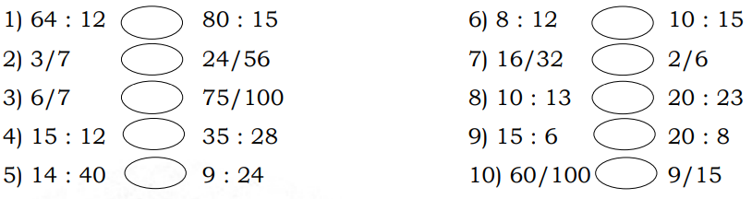
Monday to Friday | Learning Area | Learning Competency | Learning Tasks | Mode of Delivery
 |  | Identifies and writes equivalent ratios. M5NS - IIi -124 | Learning Task 3: Write the following ratios to lowest terms. Write your answers in your notebook. p. 33 20 wins to 35 games 12 red balls to 96 blue balls 250 cm to 20 m Equivalent Ratios Learning Task 1: Write = in the circle if the given pair of ratios are equal and ≠ if not. Write your answers in your notebook. p. 34 | * Track student progress in each task by Google Classroom. * Provide clear learning instructions.

Slide 44
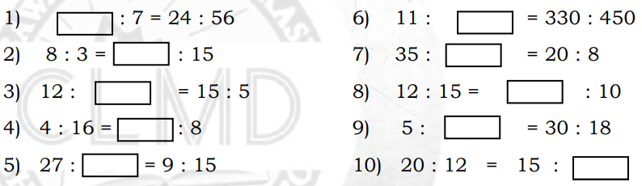
Monday to Friday | Learning Area | Learning Competency | Learning Tasks | Mode of Delivery
 |  |  | Learning Task 2: Fill each box with the correct number that will make equivalent ratios. Write your answers in your notebook. p. 34 Learning Task 3: Solve the given problems. Write your answers in your notebook. p. 34 1) Two numbers are in the ratio 2 : 3. If the bigger number is 6, what is the smaller number? | * Track student progress in each task by Google Classroom. * Provide clear learning instructions.

Slide 45
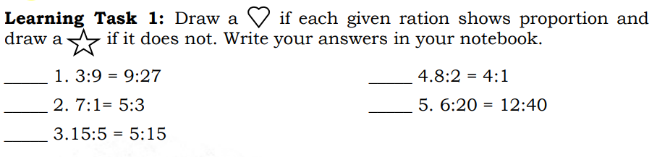
Monday to Friday | Learning Area | Learning Competency | Learning Tasks | Mode of Delivery
 |  | Defines and describes a proportion. M5NS - IIj -127 | Definition and Description of a Proportion Learning Task 2: Read and analyze the problem. Write your answers in your notebook. p. 36 A bag of N & N sweets contains just yellow and orange sweets. For every 2 yellow sweets, there are 6 orange sweets. Complete the table below, then answer the questions that follow. | * Track student progress in each task by Google Classroom. * Provide clear learning instructions.

Slide 46
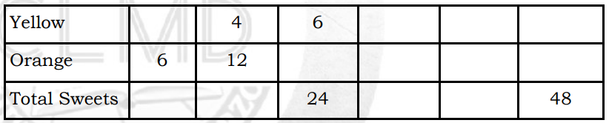
Monday to Friday | Learning Area | Learning Competency | Learning Tasks | Mode of Delivery
 |  |  | What is the ratio of orange to yellow sweets? If you have 8 yellow sweets, how many orange sweets will you have? Learning Task 3: Solve the given problems. Write your answers in your notebook. p. 36 What number compared to 10 is the same as 25 compared to 5? Juliana saves P60.00 in 4 weeks. At this rate, how long will it take to generate P300.00? | * Track student progress in each task by Google Classroom. * Provide clear learning instructions.

Slide 47
Thanks!
Do you have any questions?
titserlarisel@gmail.com
MAAM LARISEL

