Slide 1
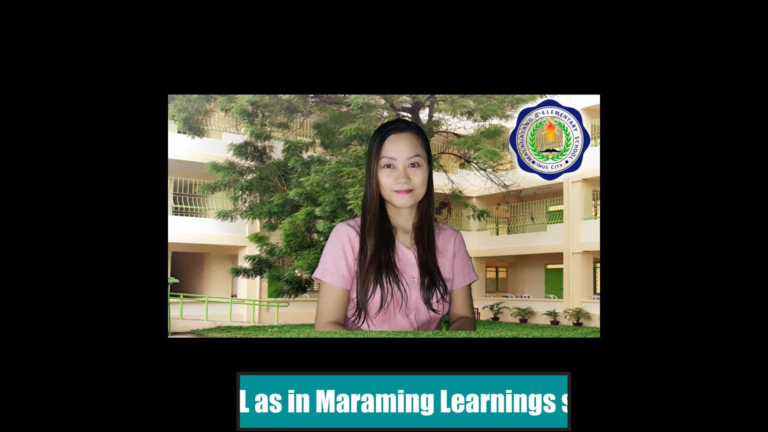
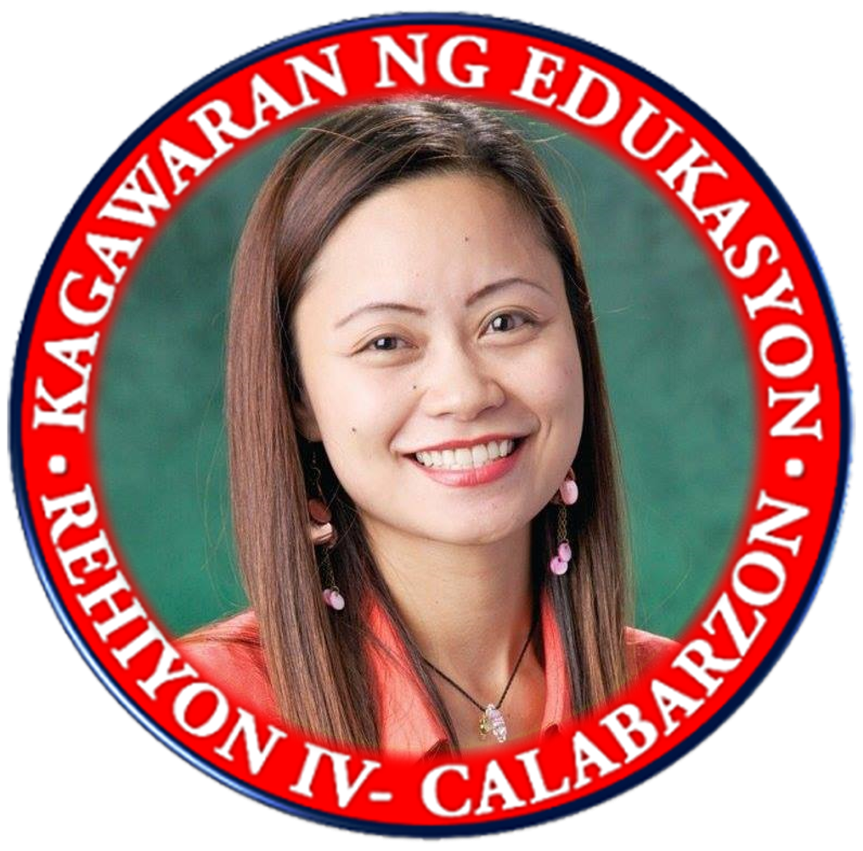

MAAM LARISEL

Slide 2


ENGLISH 5
QUARTER 2
WEEKS 1-3
(VERBS)

Slide 3

Republic of the Philippines
Department of Education
REGION IV-A
SCHOOLS DIVISION OFFICE OF IMUS CITY
NAME OF SCHOOL
WEEKLY HOME LEARNING PLAN
Grade and Section: _______________ Quarter 2 Week 1-3
Adviser: ________________________ Date:__________
Monday to Friday | Learning Area | Learning Competency | Learning Tasks | Mode of Delivery
8:00-8:45 | ENGLISH | Compose clear and coherent sentences using appropriate grammatical structures: aspects of verbs, modals and conjunction EN5G-Ia-3.3 | Learning Task 1: Write the correct form of the verb listen as indicated in the parentheses. Do this in your notebook. p.6 I ___________ to bedtime stories every night. (simple present tense) She ___________ to the news yesterday. (simple past tense) Yeng ___________ to her newly downloaded songs tonight. (simple future tense) | * Track student progress in each task by Google Classroom. * Provide clear learning instructions.

Slide 4
Monday to Friday | Learning Area | Learning Competency | Learning Tasks | Mode of Delivery
 |  |  | Learning Task 2: Identify the appropriate simple present tense of the verb to be used in each item. Write your answers in your notebook. p.9 Water (are, is) a resource that every living thing cannot live without. I (think, thinks) about the importance of water in our daily activities. The learners (answer, answers) the questions about water conservation. Learning Task 3: Identify the appropriate simple past tense of the verb to be used in each item. Write your answers in your notebook. p.9 The tourist (go, went) to Palawan last month. She (hears, heard) about its beautiful spots through ads. I (remembered, remember) my trip to Palawan five years ago. | * Track student progress in each task by Google Classroom. * Provide clear learning instructions.

Slide 5
Monday to Friday | Learning Area | Learning Competency | Learning Tasks | Mode of Delivery
 |  |  | Learning Task 4: Write the simple future tense of each given verb inside the parenthesis. Do this in your notebook. p.10 1. As responsible members of the community, we __________ (participate) in the clean-up drive and tree planting activities to be organized this coming year. Learning Task 5: Copy the table below in your notebook. Then, identify the forms of the verbs study and prepare using the aspects of verbs indicated in Column. p.10 1. Forms of the verb know in Column 2 serve as an example. | * Track student progress in each task by Google Classroom. * Provide clear learning instructions.

Slide 6
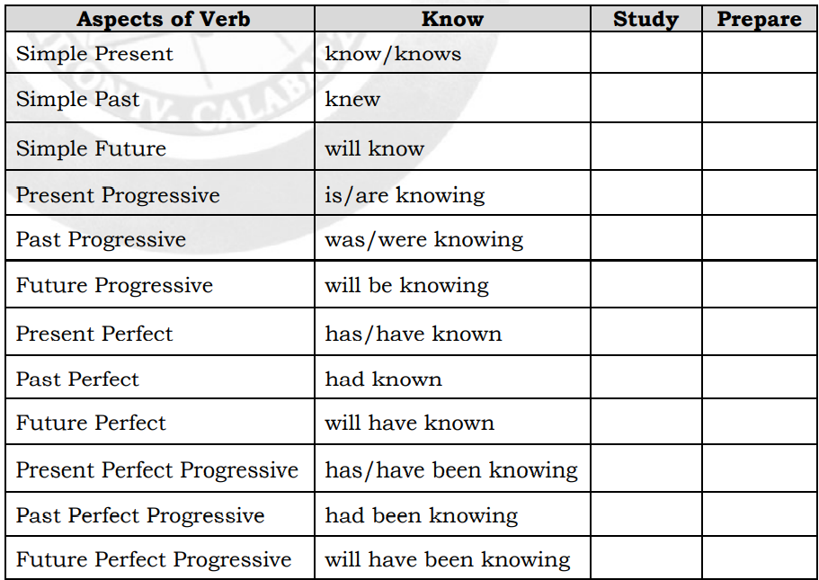
Monday to Friday | Learning Area | Learning Competency | Learning Tasks | Mode of Delivery
 |  |  | Learning Task 6: Compose clear and coherent sentences using the given verbs and their aspects. Write your sentences in your notebook. p.11 | * Track student progress in each task by Google Classroom. * Provide clear learning instructions.

Slide 7
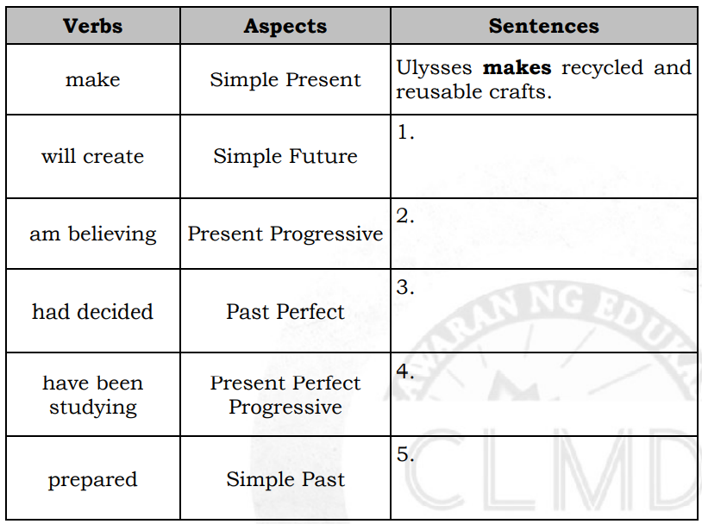
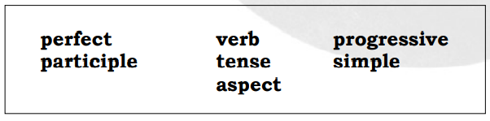
Monday to Friday | Learning Area | Learning Competency | Learning Tasks | Mode of Delivery
 |  |  | Complete the paragraphs below by supplying the missing terms. Select from the given choices below. Write your answers in your notebook. p.11 | * Track student progress in each task by Google Classroom. * Provide clear learning instructions.

Slide 8
Monday to Friday | Learning Area | Learning Competency | Learning Tasks | Mode of Delivery
 |  |  | A (1)__________ is composed of tense and aspect. A verb (2)__________ or the time event is indicated by past, present and future. Meanwhile, (3)__________ refers to the state of action of a verb and indicates the duration or completion of an event. There are four types of verb aspects: (4)__________, (5)__________, (6)__________ and perfect progressive. | * Track student progress in each task by Google Classroom. * Provide clear learning instructions.

Slide 9
ENGLISH 5
QUARTER 2
WEEKS 1-3
(MODALS)

Slide 10
Republic of the Philippines
Department of Education
REGION IV-A
SCHOOLS DIVISION OFFICE OF IMUS CITY
NAME OF SCHOOL
WEEKLY HOME LEARNING PLAN
Grade and Section: _______________ Quarter 2 Week 1-3
Adviser: ________________________ Date:__________
Monday to Friday | Learning Area | Learning Competency | Learning Tasks | Mode of Delivery
8:00-8:45 | ENGLISH | Compose clear and coherent sentences using appropriate grammatical structures: aspects of verbs, modals and conjunction EN5G-Ia-3.3 | Learning Task 1: Complete each sentence by supplying the appropriate modals. Select from the given choices. Be guided by the functions shown inside the parentheses. Do this in your notebook. p.12 ___________ we go? (suggestion) ___________ you lend me your books? (polite request) I __________ visit you more often since my place is just nearby. (ability) | * Track student progress in each task by Google Classroom. * Provide clear learning instructions.
can shall would may should

Slide 11
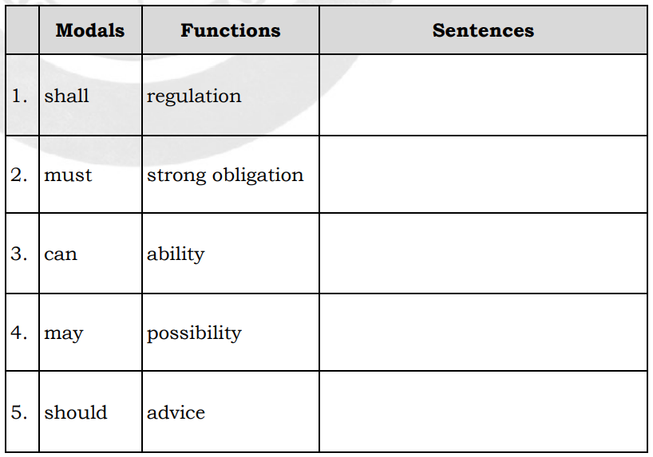
Monday to Friday | Learning Area | Learning Competency | Learning Tasks | Mode of Delivery
 |  |  | Learning Task 2: Complete each sentence by supplying the appropriate modals. Select from the given choices. Be guided by the functions shown inside the parentheses. Do this in your notebook. p.14 I __________ write a song or poem for my parents. (ability) Learning Task 3: Compose clear and coherent sentences using the given modals and their functions below. Write your sentences in your notebook. p.14 | * Track student progress in each task by Google Classroom. * Provide clear learning instructions.
can shall would may should

Slide 12
Monday to Friday | Learning Area | Learning Competency | Learning Tasks | Mode of Delivery
 |  |  | What are your skills or talents? Complete the prompts below using the given modals. Do this in your notebook. I can ________________________________. I may ________________________________. I shall _______________________________. I must _______________________________. | * Track student progress in each task by Google Classroom. * Provide clear learning instructions.

Slide 13
ENGLISH 5
QUARTER 2
WEEKS 1-3
(CONJUNCTIONS)

Slide 14
Republic of the Philippines
Department of Education
REGION IV-A
SCHOOLS DIVISION OFFICE OF IMUS CITY
NAME OF SCHOOL
WEEKLY HOME LEARNING PLAN
Grade and Section: _______________ Quarter 2 Week 1-3
Adviser: ________________________ Date:__________
Monday to Friday | Learning Area | Learning Competency | Learning Tasks | Mode of Delivery
8:00-8:45 | ENGLISH | Compose clear and coherent sentences using appropriate grammatical structures: aspects of verbs, modals and conjunction EN5G-Ia-3.3 | Learning Task 1: Identify the best conjunction to be used in each item. Select from the given options below. Do this in your notebook. p.16 Yazzy will watch horror __________ comedy movies this Sunday. Sam decided not to come to the party __________ he suddenly changed his mind. | * Track student progress in each task by Google Classroom. * Provide clear learning instructions.
whenever so that even though but and

Slide 15
Monday to Friday | Learning Area | Learning Competency | Learning Tasks | Mode of Delivery
 |  |  | Learning Task 2: Complete each sentence below by supplying the appropriate coordinating conjunction. Choose from the given options inside the box. Write your answers in your notebook. p.18 Each school year is an opportunity to meet new classmates (1) ________ new friends. You may call these new acquaintances by their first names (2) ________ by their nicknames. They can be of the same age as you, (3) ________ others can be younger or older. Newcomers must be welcomed and must feel the sense of belongingness, (4) ________ children like you must always be friendly. This healthy relationship in school must be sustained (5) ________ this may help every learner to have positive attitude towards schooling. | * Track student progress in each task by Google Classroom. * Provide clear learning instructions.
for and but or so

Slide 16
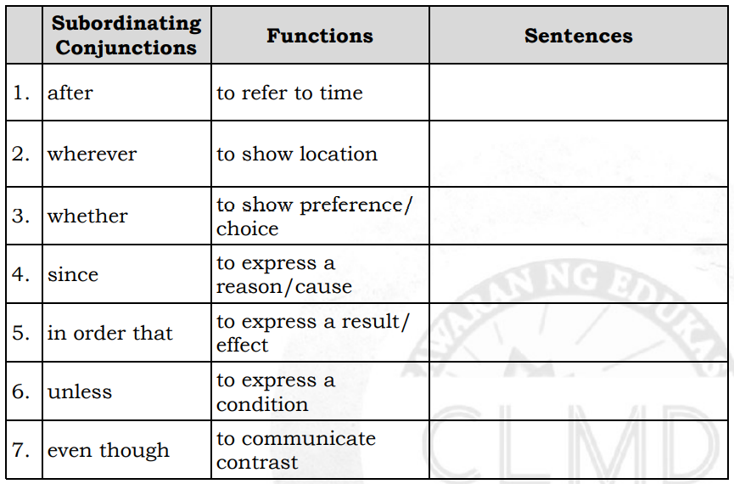
Monday to Friday | Learning Area | Learning Competency | Learning Tasks | Mode of Delivery
 |  |  | Learning Task 3: Compose clear and coherent sentences using the given subordinating conjunctions and their functions below. Do this in your notebook. p.19 | * Track student progress in each task by Google Classroom. * Provide clear learning instructions.

Slide 17
Monday to Friday | Learning Area | Learning Competency | Learning Tasks | Mode of Delivery
 |  |  | Complete the paragraphs below by supplying the appropriate terms or words. Select from the given choices inside the box. Do this in your notebook. p.19 (1)__________ connect words, phrases, clauses, or sentences. There are (2)__________ types of conjunctions: the coordinating and subordinating conjunctions. (3)__________ conjunctions connect words or groups of words that are of (4)__________ importance. If you are using a coordinating conjunction to connect two complete sentences, you must use a comma. Remember the acronym (5)__________. Meanwhile, (6)__________ conjunctions join two clauses making one clause (7)__________ or subordinate of the other clause. | * Track student progress in each task by Google Classroom. * Provide clear learning instructions.
dependent Conjunctions two Coordinating modals subordinating equal FANBOYS

Slide 18
ENGLISH 5
QUARTER 2
WEEKS 4 - 5
(Point-of-View)

Slide 19
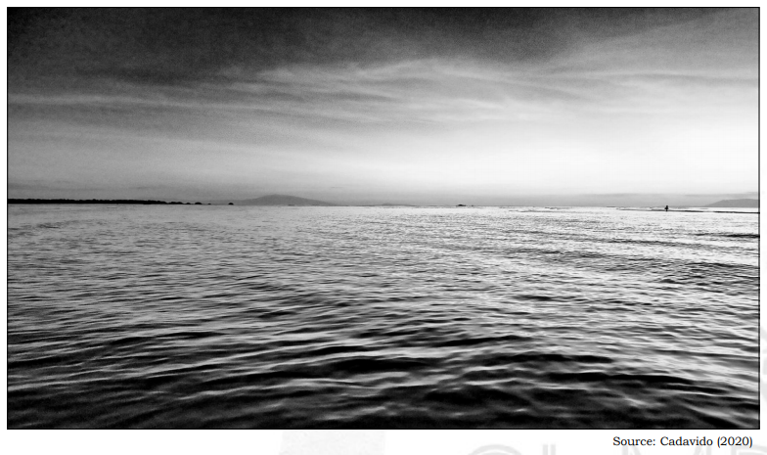
Republic of the Philippines
Department of Education
REGION IV-A
SCHOOLS DIVISION OFFICE OF IMUS CITY
NAME OF SCHOOL
WEEKLY HOME LEARNING PLAN
Grade and Section: _______________ Quarter 2 Week 1-3
Adviser: ________________________ Date:__________
Monday to Friday | Learning Area | Learning Competency | Learning Tasks | Mode of Delivery
8:00-8:45 | ENGLISH | Identify point-of-view EN5VC-IIh7.3 | Learning Task 1: Look at the picture about sunset. Give at least five (5) words that will best describe it. Do this in your notebook. p.21 | * Track student progress in each task by Google Classroom. * Provide clear learning instructions.

Slide 20
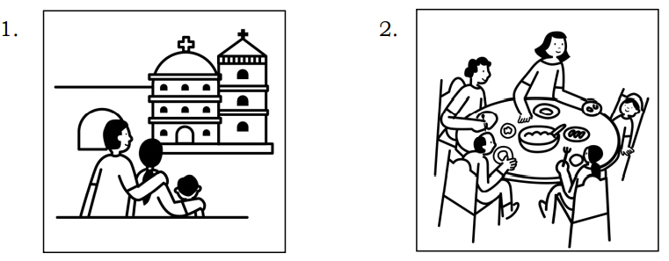
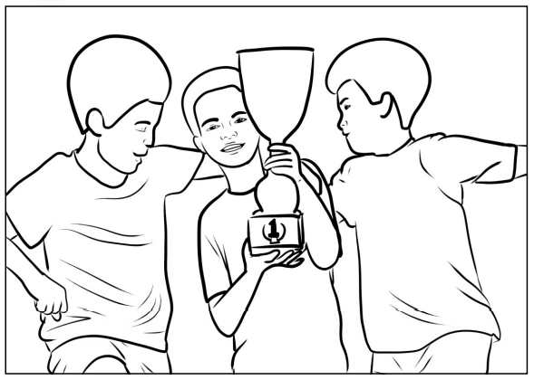
Monday to Friday | Learning Area | Learning Competency | Learning Tasks | Mode of Delivery
 |  |  | Learning Task 2: Describe the feelings or emotions expressed by each illustration below. Write your answers in your notebook. p.21 Learning Task 3: In your notebook, write three to five sentences expressing your point-of-view about the illustration below. p.22 | * Track student progress in each task by Google Classroom. * Provide clear learning instructions.

Slide 21
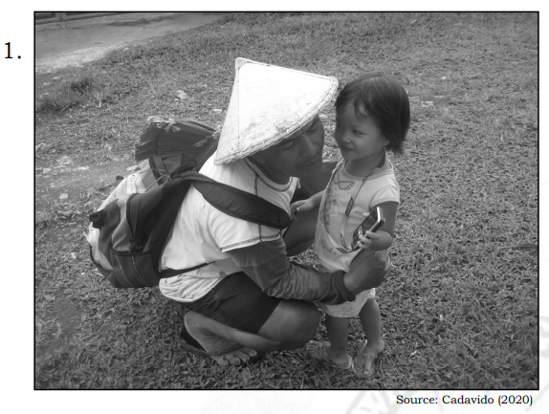
Monday to Friday | Learning Area | Learning Competency | Learning Tasks | Mode of Delivery
 |  |  | Learning Task 4: Describe your point-of-view for each picture in three to five sentences. Do this in your notebook. p.23 In your notebook, paste a picture taken from old newspapers or magazines. If available, you may use any of your photos. Then, write three to five sentences describing the point-of-view expressed by your chosen picture. p.23 | * Track student progress in each task by Google Classroom. * Provide clear learning instructions.

Slide 22
ENGLISH 5
QUARTER 2
WEEKS 6 - 7
(ViewPoints of Images )

Slide 23
Republic of the Philippines
Department of Education
REGION IV-A
SCHOOLS DIVISION OFFICE OF IMUS CITY
NAME OF SCHOOL
WEEKLY HOME LEARNING PLAN
Grade and Section: _______________ Quarter 2 Week 1-3
Adviser: ________________________ Date:__________
Monday to Friday | Learning Area | Learning Competency | Learning Tasks | Mode of Delivery
8:00-8:45 | ENGLISH | Examine images which present particular viewpoints, e.g. stereotypes (gender, age, cultural), opinions on an issue EN5VC-IIh7.1 EN5VC-IIh7.2 | Learning Task 1: Examine the images below. Tell the opinion suggested by each image. Select your answers from the given choices below. Write only the letters of your answers in your notebook. p.25 Ladies maintain proper hygiene. Boys are good painters. Old people want a quiet place most of the time. Filipinos are family-oriented. Filipino families are religious. | * Track student progress in each task by Google Classroom. * Provide clear learning instructions.

Slide 24
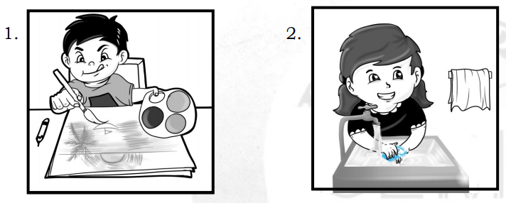
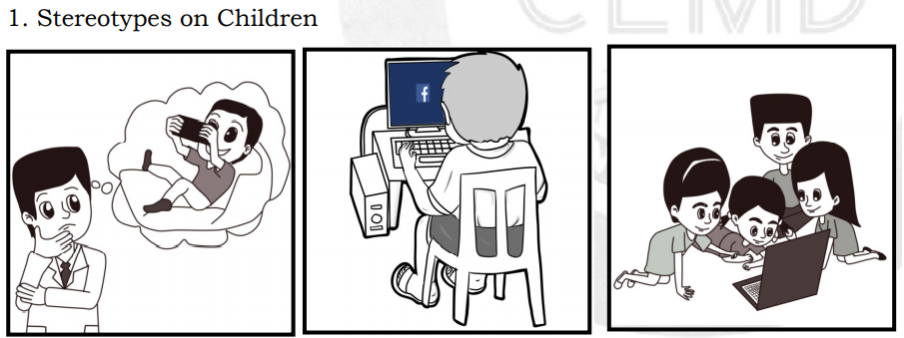
Monday to Friday | Learning Area | Learning Competency | Learning Tasks | Mode of Delivery
 |  |  | Learning Task 2: Examine the images below and their presented viewpoints. In your notebook, write a 3-sentence paragraph for each item stating your opinions and feelings about the given sets of images. p.27 | * Track student progress in each task by Google Classroom. * Provide clear learning instructions.

Slide 25
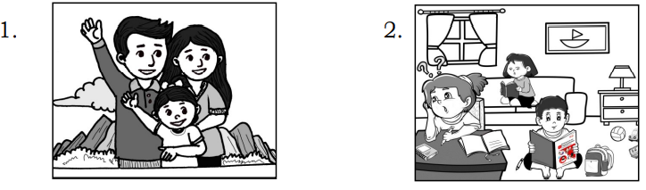
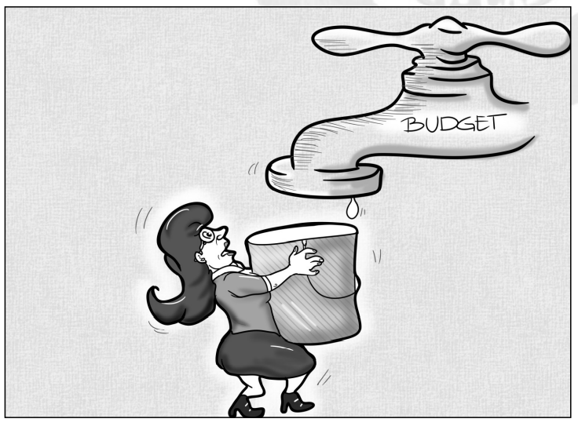
Monday to Friday | Learning Area | Learning Competency | Learning Tasks | Mode of Delivery
 |  |  | Learning Task 3: Examine the images below and their presented viewpoints. Put checks ( ✓ ) on images that you can relate to based on your own experiences. Write your answers in your notebook. p.28 Learning Task 4: Examine the given editorial cartoon below and its expressed viewpoints. In your notebook, write a 5-sentence paragraph stating your opinions and feelings. p.28 | * Track student progress in each task by Google Classroom. * Provide clear learning instructions.

Slide 26
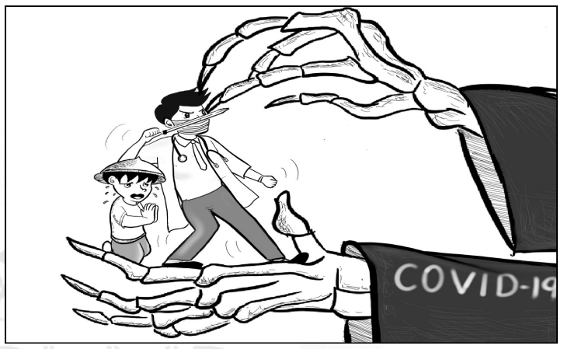
Monday to Friday | Learning Area | Learning Competency | Learning Tasks | Mode of Delivery
 |  |  | Learning Task 5: Examine the given editorial cartoon and its expressed viewpoints. Write a 5-sentence paragraph in your notebook stating your opinions and feelings about it. p.30 Cut out two (2) printed images from newspapers, magazines or other printed materials. Next, paste them on the pages of your notebook. Then, write paragraphs stating your viewpoints/feelings/opinions for each image. p.30 | * Track student progress in each task by Google Classroom. * Provide clear learning instructions.

Slide 27
ENGLISH 5
QUARTER 2
WEEK 8
(Type of Viewing
Materials)

Slide 28
Republic of the Philippines
Department of Education
REGION IV-A
SCHOOLS DIVISION OFFICE OF IMUS CITY
NAME OF SCHOOL
WEEKLY HOME LEARNING PLAN
Grade and Section: _______________ Quarter 2 Week 1-3
Adviser: ________________________ Date:__________
Monday to Friday | Learning Area | Learning Competency | Learning Tasks | Mode of Delivery
8:00-8:45 | ENGLISH | Distinguish among various types of viewing materials. EN5VC-Id-6 | Learning Task 1: Identify the types of the given viewing materials. In your notebook, write PM for print material and NPM for non-print material. p.32 _____1. e-book _____2. photograph (in a picture frame) _____3. TV news program _____4. vlog _____5. portrait | * Track student progress in each task by Google Classroom. * Provide clear learning instructions.

Slide 29
Monday to Friday | Learning Area | Learning Competency | Learning Tasks | Mode of Delivery
 |  |  | Learning Task 2: Categorize the viewing materials below according to their types. Use the chart below. Write your answers in your notebook. p.32 | * Track student progress in each task by Google Classroom. * Provide clear learning instructions.
book printed world map video clip EduTV show picture book
Print-Material | Non-Print Material

Slide 30
Monday to Friday | Learning Area | Learning Competency | Learning Tasks | Mode of Delivery
 |  |  | Learning Task 3: Analyze the following and pick out the word that does not belong to the set of viewing materials. Write your answers in your notebook. p.33 e-picture books, videos, virtual presentations, printed poster TV documentaries, books, radio comedies, movies Learning Task 4: After eliminating the material which does not belong to each group in Learning Task 4, classify the remaining materials as to PRINT or NON-PRINT. Write your answers in your notebook. p.34 ________________________________ ________________________________ ________________________________ ________________________________ ________________________________ | * Track student progress in each task by Google Classroom. * Provide clear learning instructions.

Slide 31
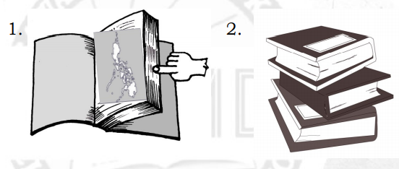
Monday to Friday | Learning Area | Learning Competency | Learning Tasks | Mode of Delivery
 |  |  | Learning Task 5: Determine whether each viewing material is PRINT or NOT. Do this in your notebook. Learning Task 6: Identify the specific viewing material that you will use in learning about the planets of the Solar System. Choose your answers from the choices inside the box. | * Track student progress in each task by Google Classroom. * Provide clear learning instructions.
Poster Documentaries Model YouTube video DepEd Commons

Slide 32
Monday to Friday | Learning Area | Learning Competency | Learning Tasks | Mode of Delivery
 |  |  | Online Videos - __________________ TV Show - __________________ Non-print/ 3D material - ______________ Print/ 2D material - __________________ Online Books/Materials - ______________ Learning Task 7: Tell whether the material used is print or non-print. Write your answers in your notebook. Maita needs to watch news on television. Complete the paragraphs below by supplying the missing terms. Select from the given choices below. Write your answers in your notebooks. | * Track student progress in each task by Google Classroom. * Provide clear learning instructions.
non-print multimedia
Print digital Viewing

Slide 33
Monday to Friday | Learning Area | Learning Competency | Learning Tasks | Mode of Delivery
 |  |  | (1)__________ helps learners in reflecting and thinking about the images they are seeing, and develops their knowledge and skills in analyzing and evaluating visual and (2)__________ texts. There are two types of viewing materials. (3)__________ viewing materials consist of all printed images found in textbooks, workbooks, reference books, magazines, newspapers and journals. Meanwhile, (4)__________ viewing materials are those that do not depend on the printed sources such as three-dimensional arts like diorama, globes, puppets and models; and other projected materials. | * Track student progress in each task by Google Classroom. * Provide clear learning instructions.

Slide 34
THANKS
Do you have any questions?
titserlarisel@gmail.com
MAAM LARISEL

